Slide 1
Reinforcement Learning in Games
Ege Can Özer
Notes:
RL and DL emerging once again with the recent success in AlphaGo
Today I will talk about some RL algorithms in game context
But just before that lets see why we should study RL in games

Slide 2
Motivation
Easy, controlled environment
Clear-cut rules
Concrete evaluation measurements
Easy to realize
Provides a common tool
Notes:
How presentation will benefit audience: Adult learners are more interested in a subject if they know how or why it is important to them.
Presenter’s level of expertise in the subject: Briefly state your credentials in this area, or explain why participants should listen to you.

Slide 3
Challenges
Implementation POV
Hard to find SDK, let’s create the game from scratch
Abstracting the environment
Low-level, high-level, context-free
Performance measures
No hand labeled ground-truth set
Further challenges
Exploitation vs exploration
Many problems DL perspective
Notes:
Sounds perfect up to now. But they also have some challenges.
How many of you ever wondered about how the AI of some game work in your childhood
Well from the study of RL+DL perspective, possible challenges can be listed as
1-Create the game from scratch vs use existing tools
2-What are the main elements of the game, we will actually take a close look at this in each articles
3-How good our model is
4-Exploitation vs exploration
5-DL POV

Slide 4

Outline
Reinforcement Learning to Play Mario [LYY12]
High-level Reinforcement Learning in Strategy Games [AmS10]
Temporal Difference Learning and TD-Gammon [Tes95]
Playing Atari with Reinforcement Learning [MKS13]
4 articles
Conclusion
Notes:
To be ab

Slide 5
Reinforcement Learning to Play Mario [LYY12]
Low-level
Notes:
How presentation will benefit audience: Adult learners are more interested in a subject if they know how or why it is important to them.
Presenter’s level of expertise in the subject: Briefly state your credentials in this area, or explain why participants should listen to you.

Slide 6
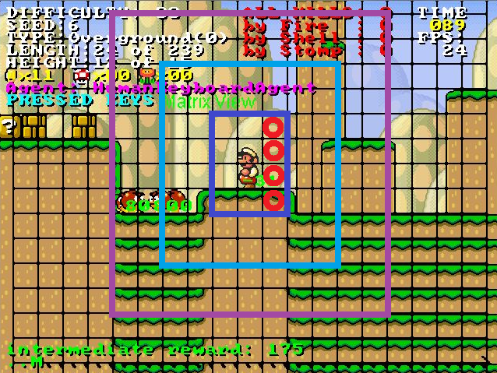
States
Actions
Reward function
Tuning parameters
Discount factor
Decreasing learning rate
Notes:
How presentation will benefit audience: Adult learners are more interested in a subject if they know how or why it is important to them.
Presenter’s level of expertise in the subject: Briefly state your credentials in this area, or explain why participants should listen to you.

Slide 7
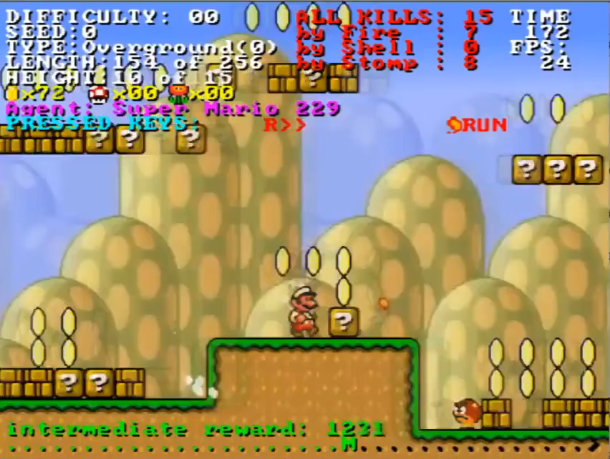
Reinforcement Learning to Play Mario [LYY12]
Four measures
Composite score
Win status
Kills in total
Distance passed
Time spent in frames
Four measures
Composite score
Winning probability
% of Monster killed
Time spent
Notes:
How presentation will benefit audience: Adult learners are more interested in a subject if they know how or why it is important to them.
Presenter’s level of expertise in the subject: Briefly state your credentials in this area, or explain why participants should listen to you.

Slide 8
High-level Reinforcement Learning in Strategy Games [AmS10]
Notes:
How presentation will benefit audience: Adult learners are more interested in a subject if they know how or why it is important to them.
Presenter’s level of expertise in the subject: Briefly state your credentials in this area, or explain why participants should listen to you.

Slide 9
High-level Reinforcement Learning in Strategy Games [AmS10]
Notes:
How presentation will benefit audience: Adult learners are more interested in a subject if they know how or why it is important to them.
Presenter’s level of expertise in the subject: Briefly state your credentials in this area, or explain why participants should listen to you.

Slide 10
High-level Reinforcement Learning in Strategy Games [AmS10]
Notes:
How presentation will benefit audience: Adult learners are more interested in a subject if they know how or why it is important to them.
Presenter’s level of expertise in the subject: Briefly state your credentials in this area, or explain why participants should listen to you.

Slide 11
Temporal Difference Learning and TD-Gammon [Tes95]
Introduce, goal of the system
Why important and unique
Notes:
1.0 : Hidden nodes: 40, 1-ply move selection
2.0 : 40 hn., 2-ply move selection (lookahead)
2.1 : 80 hidden nodes, 2-ply move selection

Slide 12
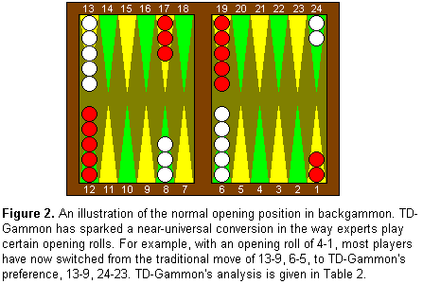
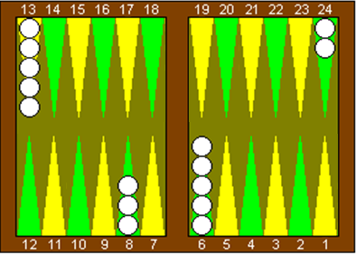
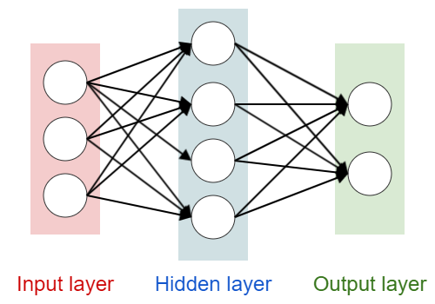
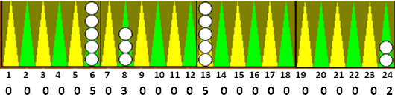

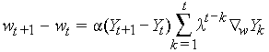
40 hidden nodes
White | Normal
Red | Gammon
algorithm is applied to change the network's weights.
Backpropagation
Self-training scheme
Scores every possible legal moves
Notes:
How presentation will benefit audience: Adult learners are more interested in a subject if they know how or why it is important to them.
Presenter’s level of expertise in the subject: Briefly state your credentials in this area, or explain why participants should listen to you.

Slide 13
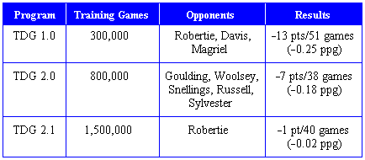
Temporal Difference Learning and TD-Gammon [Tes95]
Notes:
1.0 : Hidden nodes: 40, 1-ply move selection
2.0 : 40 hn., 2-ply move selection (lookahead)
2.1 : 80 hidden nodes, 2-ply move selection

Slide 14
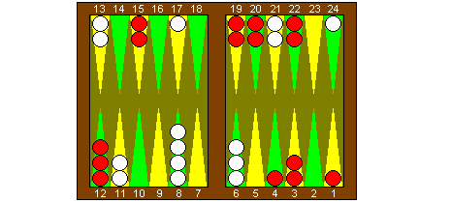
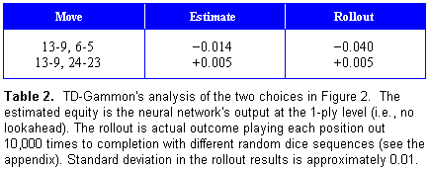
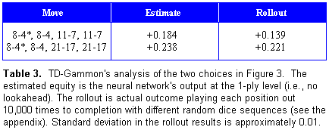
Temporal Difference Learning and TD-Gammon [Tes95]
White is to play 4 - 1
White is to play 4 - 4
Notes:
Estimated equity is the NN output at the 1-ply level
Rollout is actual outcome playing each position out 10,000 times to the end of game with different random dices

Slide 15
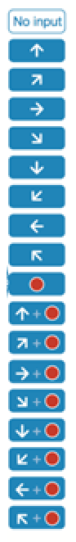
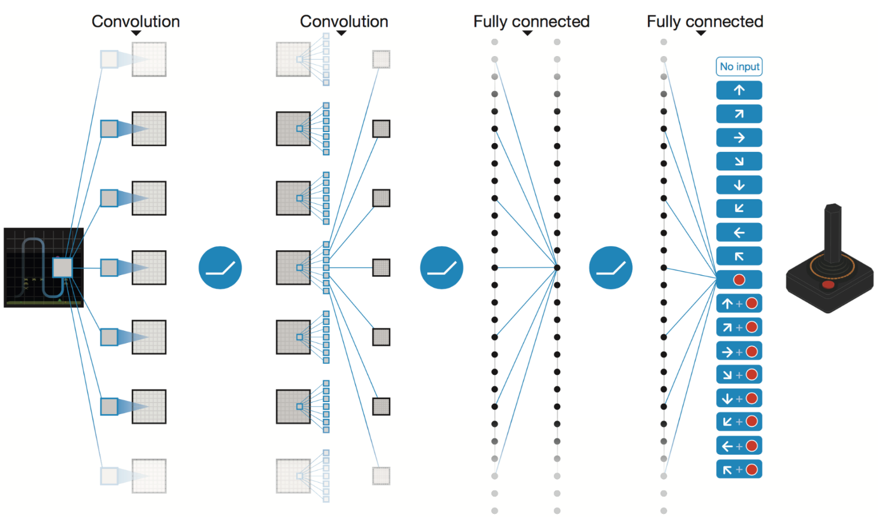
Playing Atari with Reinforcement Learning [MKS13]
Notes:
How presentation will benefit audience: Adult learners are more interested in a subject if they know how or why it is important to them.
Presenter’s level of expertise in the subject: Briefly state your credentials in this area, or explain why participants should listen to you.

Slide 16
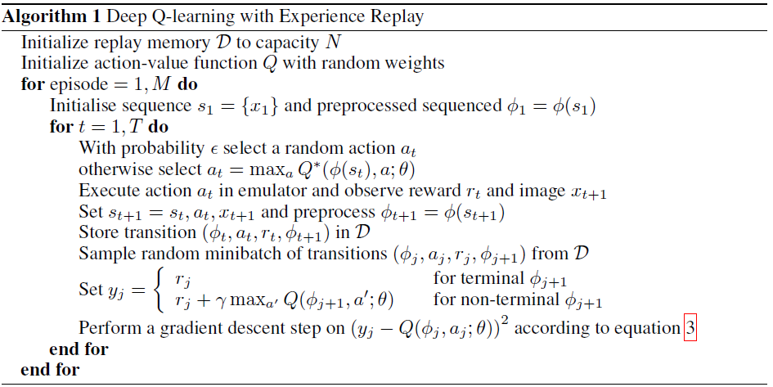

preprocessed
Game screen
Game
action = move_left
Deep Q Network
For playing
Current state
Replay memory
Preprocessor
Compute Reward
Pick an action
Game
Game screen
Preprocessor
Replay memory
Initial State
Action
Consequent reward
Consequent state
Add to
Action with highest Q-value
Random action
Replay memories
Action
Game
Notes:
How presentation will benefit audience: Adult learners are more interested in a subject if they know how or why it is important to them.
Presenter’s level of expertise in the subject: Briefly state your credentials in this area, or explain why participants should listen to you.

Slide 17
Playing Atari with Reinforcement Learning [MKS13]
Notes:
How presentation will benefit audience: Adult learners are more interested in a subject if they know how or why it is important to them.
Presenter’s level of expertise in the subject: Briefly state your credentials in this area, or explain why participants should listen to you.

Slide 18
Some problems
Context specific outcomes
Notes:
How presentation will benefit audience: Adult learners are more interested in a subject if they know how or why it is important to them.
Presenter’s level of expertise in the subject: Briefly state your credentials in this area, or explain why participants should listen to you.

Slide 19
Conclusion - What to expect next?
Summary
Sandbox learning
Unsupervised learning and reinforcement learning
Faster, stronger, less HW requirements
Notes:
How presentation will benefit audience: Adult learners are more interested in a subject if they know how or why it is important to them.
Presenter’s level of expertise in the subject: Briefly state your credentials in this area, or explain why participants should listen to you.

Slide 20
Thank you for listening!
Questions?
Notes:
How presentation will benefit audience: Adult learners are more interested in a subject if they know how or why it is important to them.
Presenter’s level of expertise in the subject: Briefly state your credentials in this area, or explain why participants should listen to you.

Slide 21
References
[AmS10] Amato, C. and Shani, G., High-level reinforcement learning in strategy games. Proceedings of the 9th International Conference on Autonomous Agents and Multiagent Systems: volume 1-Volume 1. International Foundation for Autonomous Agents and Multiagent Systems, 2010, pages 75-82.
[LYY12] Liao, Y., Yi, K. and Yang, Z., Cs229 nal report reinforcement learning to play mario. Technical Report, Technical report, Stanford University, 2012.
[Tes95] Tesauro, G., Temporal dierence learning and td-gammon. Communications of the ACM, 38,3(1995), pages 58-68.
[MKS13] Mnih, V., Kavukcuoglu, K., Silver, D., Graves, A., Antonoglou, I., Wierstra, D. and Riedmiller, M., Playing atari with deep reinforcement learning. arXiv preprint arXiv:1312.5602
Notes:
How presentation will benefit audience: Adult learners are more interested in a subject if they know how or why it is important to them.
Presenter’s level of expertise in the subject: Briefly state your credentials in this area, or explain why participants should listen to you.

